Slide 1

NuGet
Package Management solution for .NET.

Slide 2
What is NuGet
NuGet is the package manager solution for the Microsoft development platform.
The NuGet client tools provide the ability to produce and consume packages.
The NuGet Gallery is a central package repository used by all package authors and consumers.

Slide 3



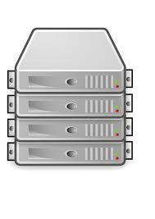

Ecosystem (flow)
GitHub
Versions Source Files
Jenkins
Versions Builds
CodeDrop
Versions Deployments
Developer
NuGet
Versions Dlls
Server

Slide 4
Ecosystem (dependencies)
The CI solution is the single abstraction point to the CodeDrop which is only depended on by servers to be deployed
Note the symmetry between the developer and the CI solution

Slide 5
Components
NuSpec
Xml file containing the specification to be packaged
NuPkg
Zip file containing the package contents, [un]install scripts, and NuSpec
NuGet Gallery
Hosted website to serve up latest or specific versions of packages (NuPkg)
NuGet VS Extension
Visual Studio Plugin to allow installation of packages
Nuget.exe
Command line application for installing packages and managing gallery

Slide 6
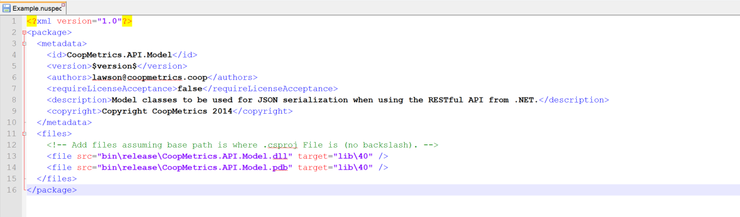
NuSpec File
This is a trivial example, you can also have specialized install and uninstall scripts referenced for complicated projects (i.e. jQuery).
Heavy use of convention in absence of declarative!

Slide 7
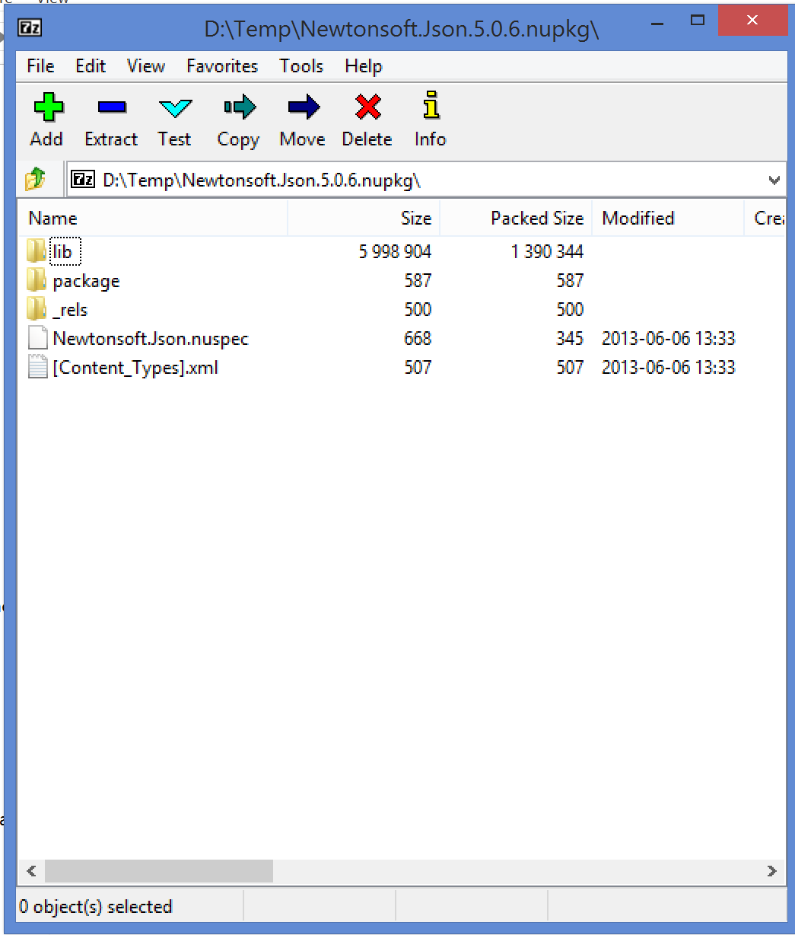
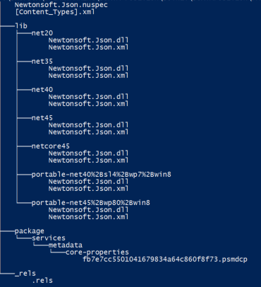
NuPkg File
This is a simple type of package so in absence of special logic NuGet will be add a reference pointing at the matching framework dir to the csproj in question.

Slide 8
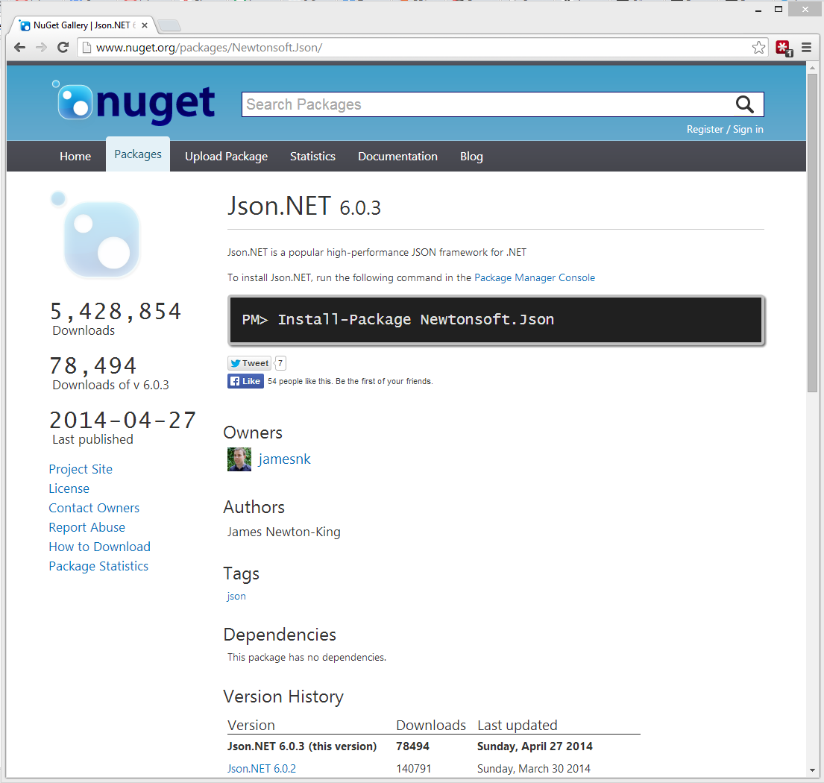
Gallery
The public gallery is good for openly shared code.
You can also host private galleries and configure them locally.
NuGet will check both locations for referenced packages…
Private can be done:
Local folder based
Small version (no DB)
Full version (requires DB)
Service (like MyGet)

Slide 9
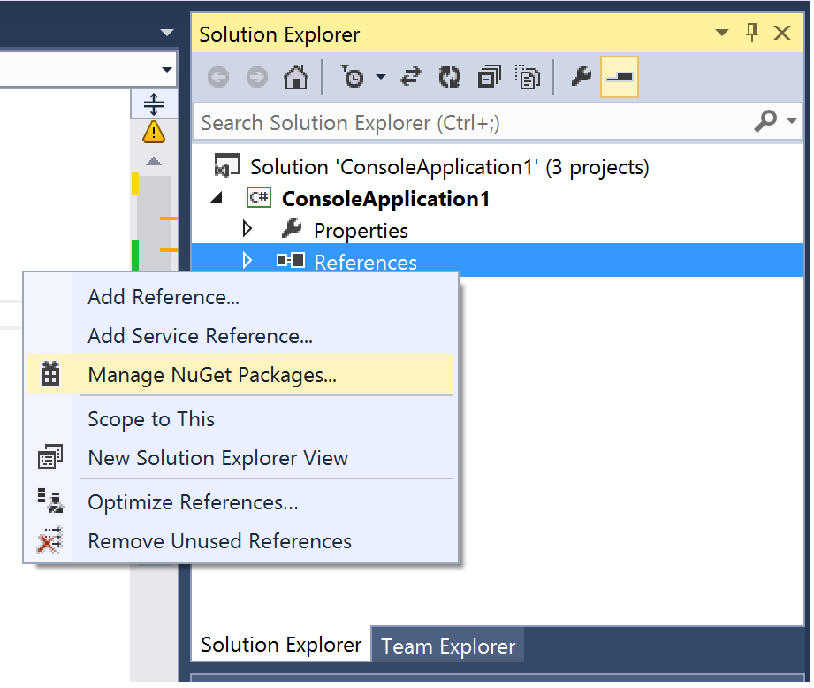
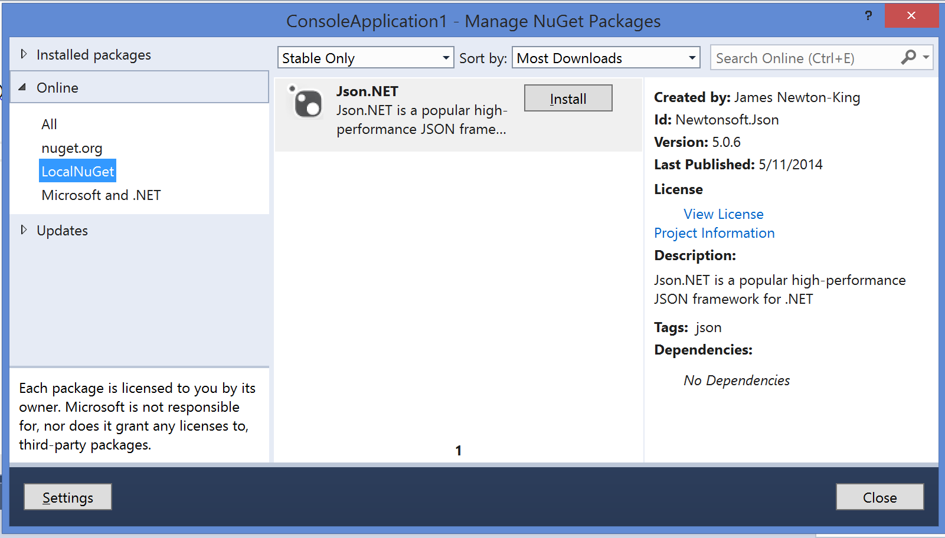
Visual Studio Integration (GUI - Nav)

Slide 10
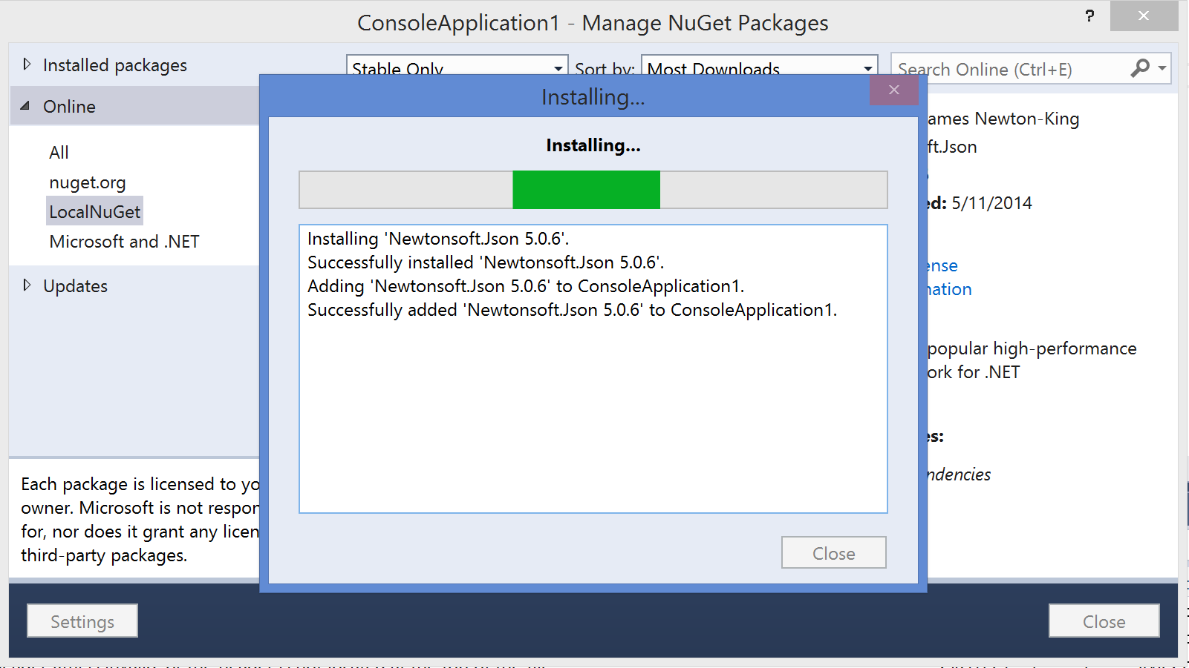
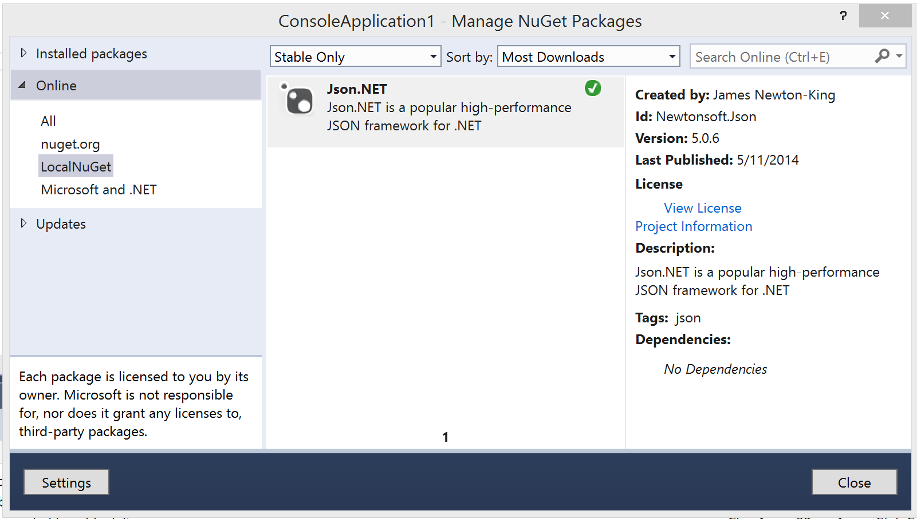
Visual Studio Integration (GUI - Install)

Slide 11
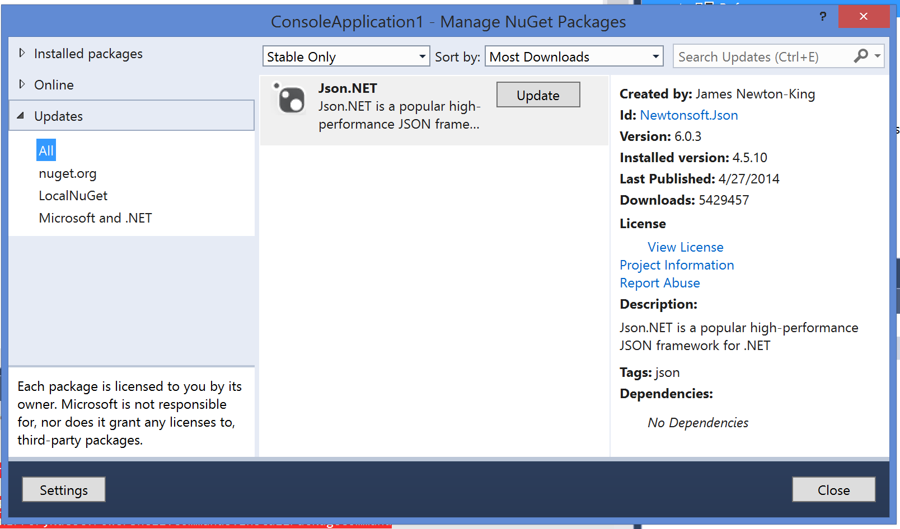
Visual Studio Integration (GUI - Update)

Slide 12
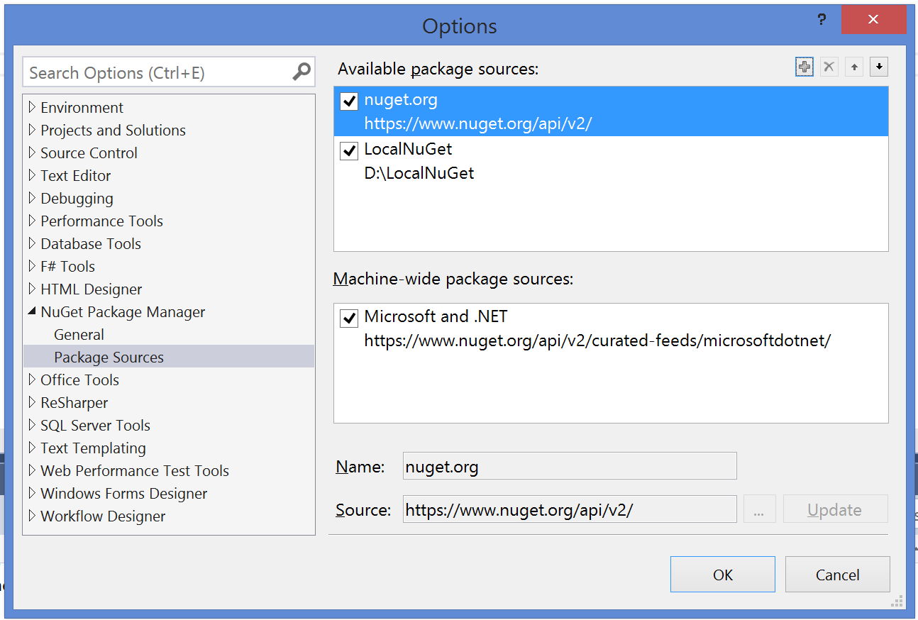
Visual Studio Integration (GUI - Settings)

Slide 13
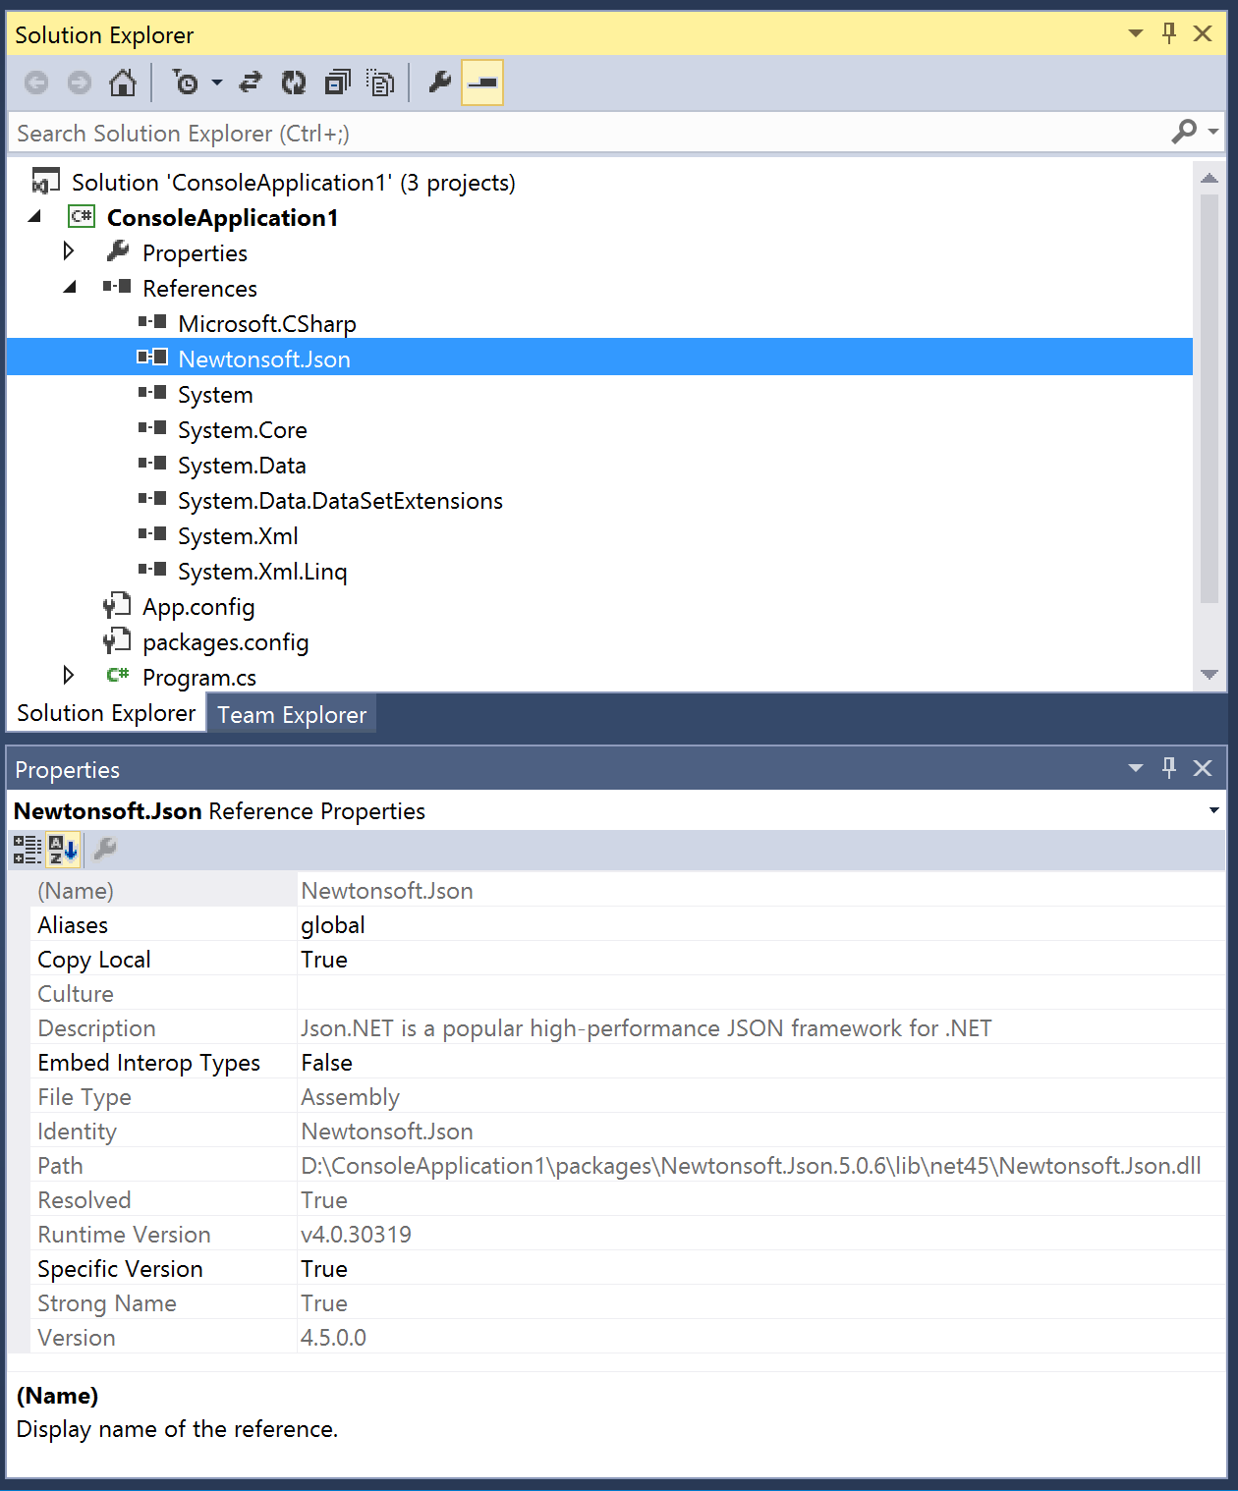
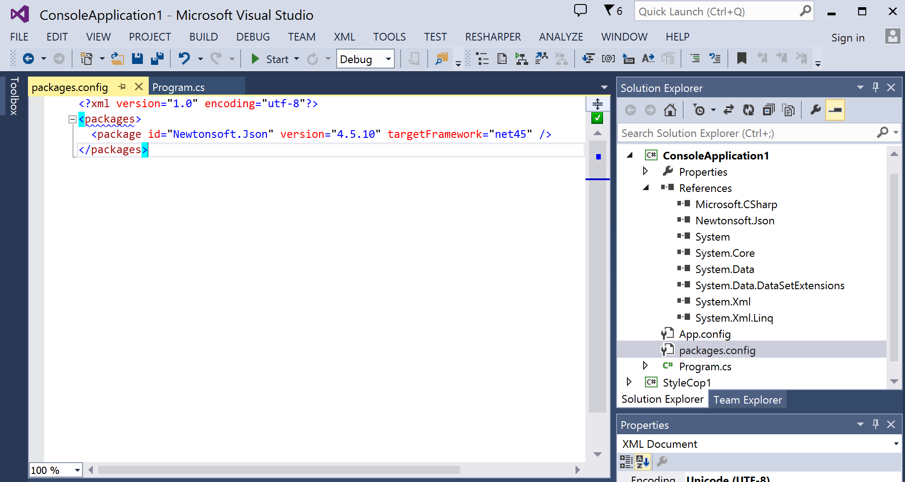
Visual Studio Integration (GUI - References)

Slide 14
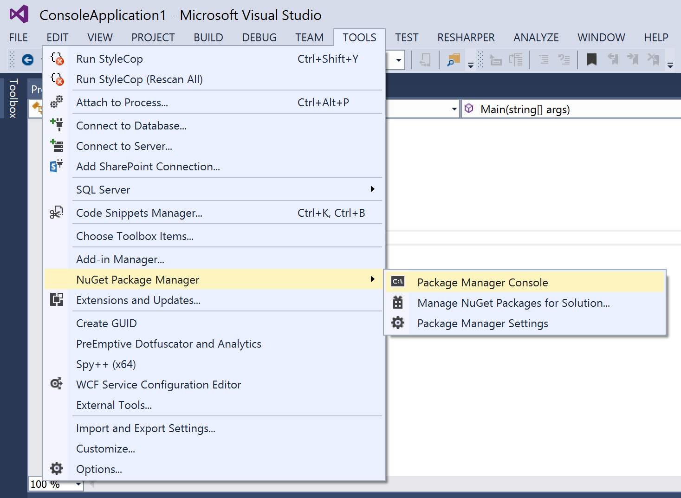
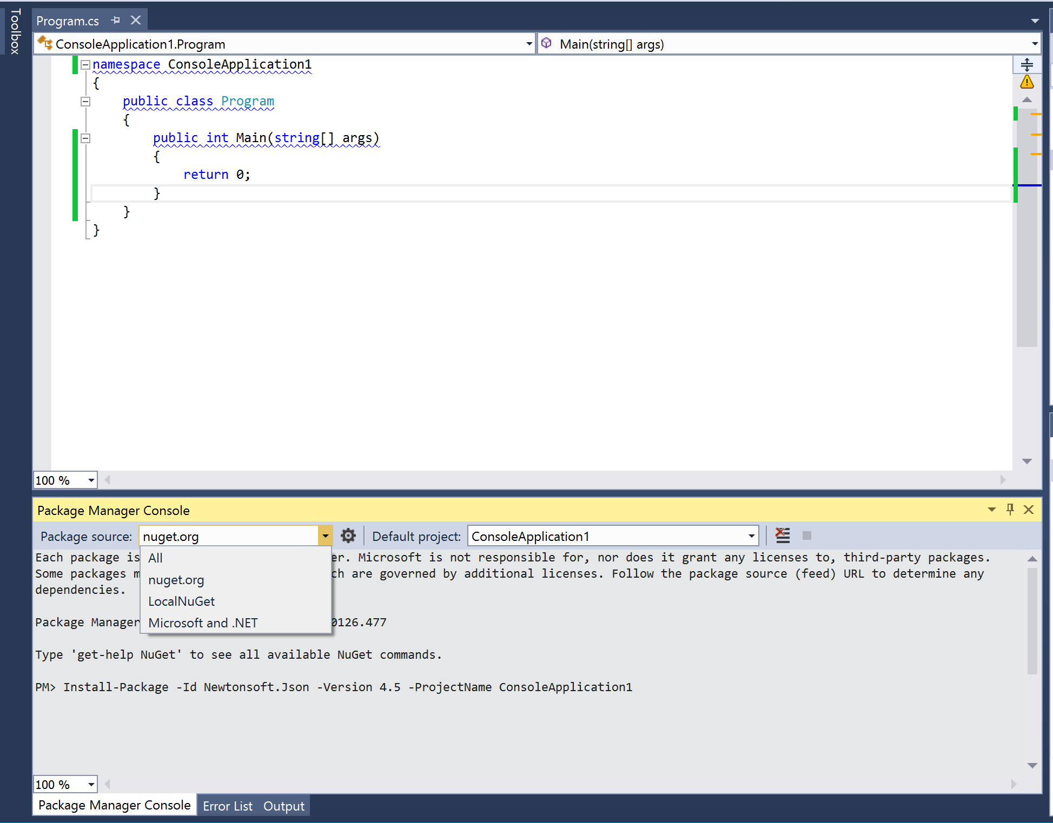
VS (Package Management Console)
Powershell with some loaded modules.
Allows specific version installation as well as uninstall.

Slide 15
NuGet.exe (command line interface)
nuget.exe help [feature (i.e. pack)]
Help lists commands and can be combined with a command to get info
nuget.exe pack [PackageID].nuspec –version 1.1.0.0
First the NuSpec is used to construct the package file via the ‘pack’ stage
nuget.exe push [PackageID].nupkg [API Key] –Source [Gallery]
Next the created NuPkg is loaded into the appropriate gallery via the ‘push’ stage
nuget.exe install [packages.config file OR package id]
When packages are in the gallery you can install them locally
nuget.exe update [solution file OR project file]
When packages are in the gallery you can update to latest version

Slide 16
Resources
NuGet Source – http://nuget.codeplex.com/
NuGet Public Gallery - http://www.nuget.org/
MyGet – Private Gallery as a service - https://www.myget.org/
Author: Lawson Caudill – http://www.getthinktank.com

